Slide 1
Stocks Portfolio Manager
INFO 6150 FINAL PROJECT
Jay Doshi
Anay Pampatwar
Moinuddin Khaja
Swapnil Biradar

Slide 2
Purpose
With the increased trend in Investment in Equity market, people are interested in learning about it more and more. But people are often sceptical to invest their hard earned money in the actual market directly.
Out Share Trading Platform comes to the rescue. The users can login or register on our webapp and practice real-time trading with virtual money to sharpen their knowledge of how the stock market works. Every user is given $500,000 in their wallet. He can make use of it to invest in shares of his choice.

Slide 3
TECHSTACK
Built using React.JS
Appropriate Flow for User Register & User Login using JWT Authentication
Node.js Express Architecture with CORS, Authentication & Authorization middleware, Mongoose
Used Mongoose to interact with MongoDB Database.
Axios making HTTP requests to fetch or save data client-side.
Used HTTP REST API for getting stock price data from finnhub.io and trading view

Slide 4
Features
1
2
3
4
5
6
7
8
Login/Register
Charts
Stock Listings
Buy/Sell Stocks
Watchlist
Portfolio
Trade History
IPO and News

Slide 5
APIs Used
finnhub.io
TradingView
a third party finance API that provides real time stock market price, stock news and IPO listings.
a REST API that provides real time stock market charts.

Slide 6
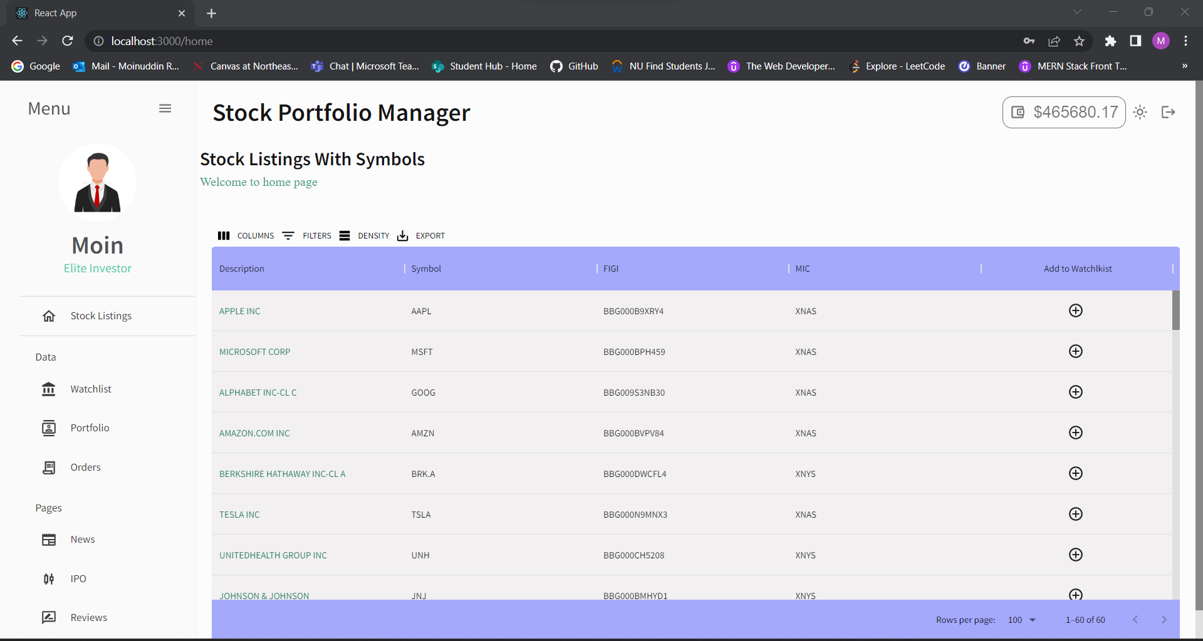

Slide 7
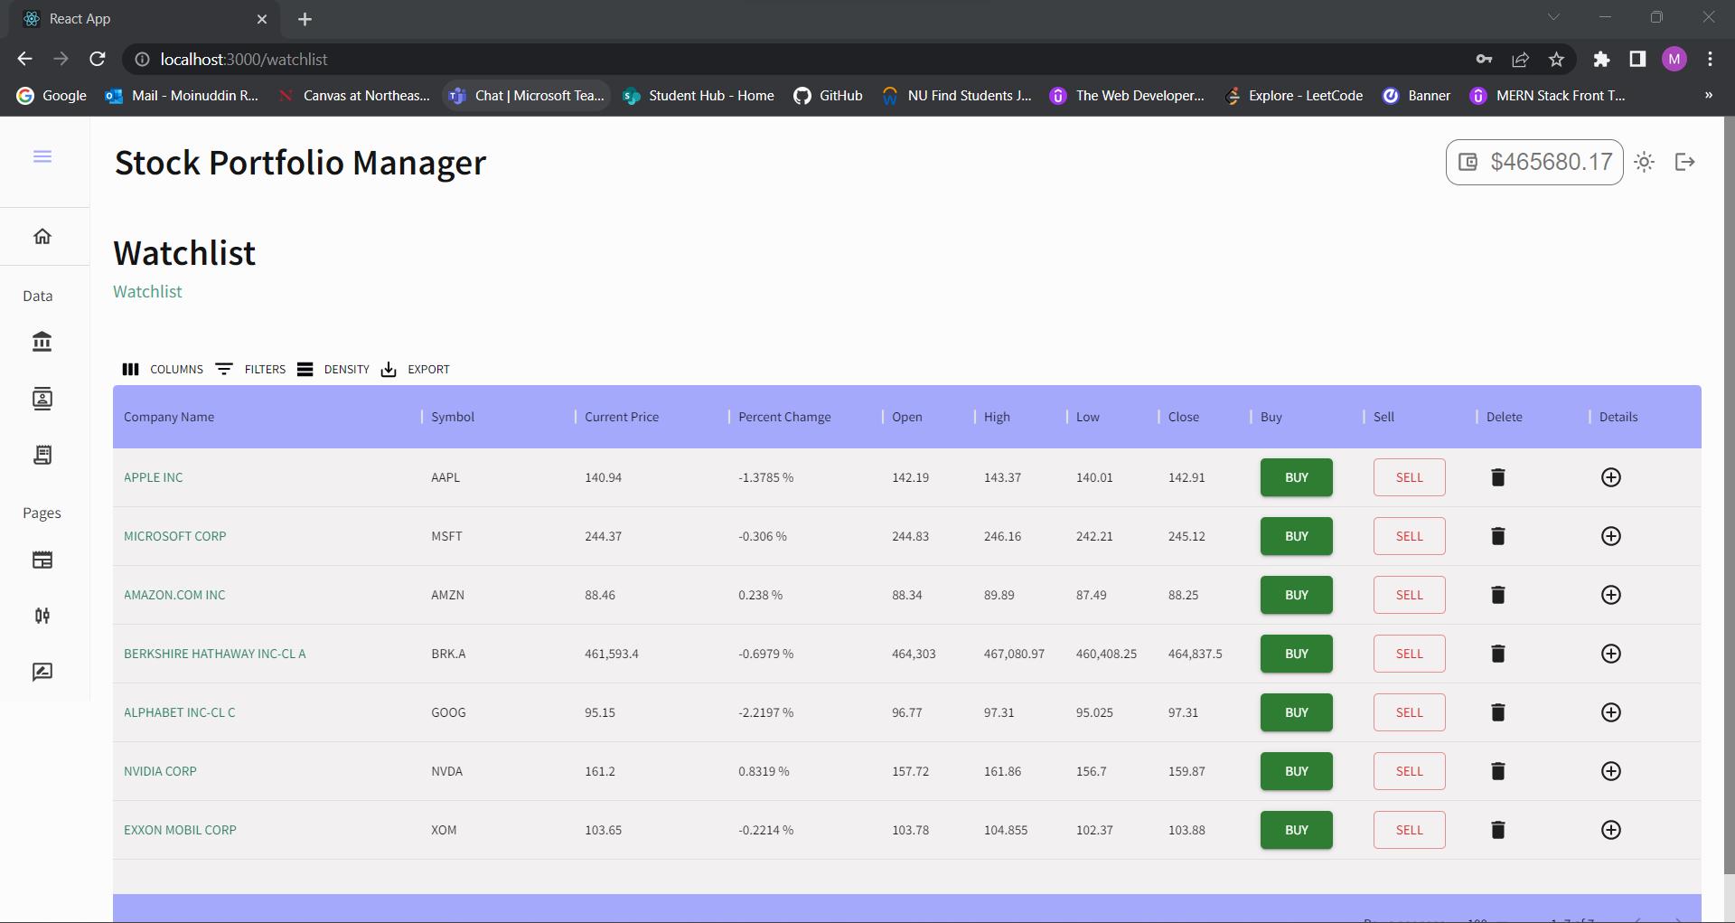

Slide 8
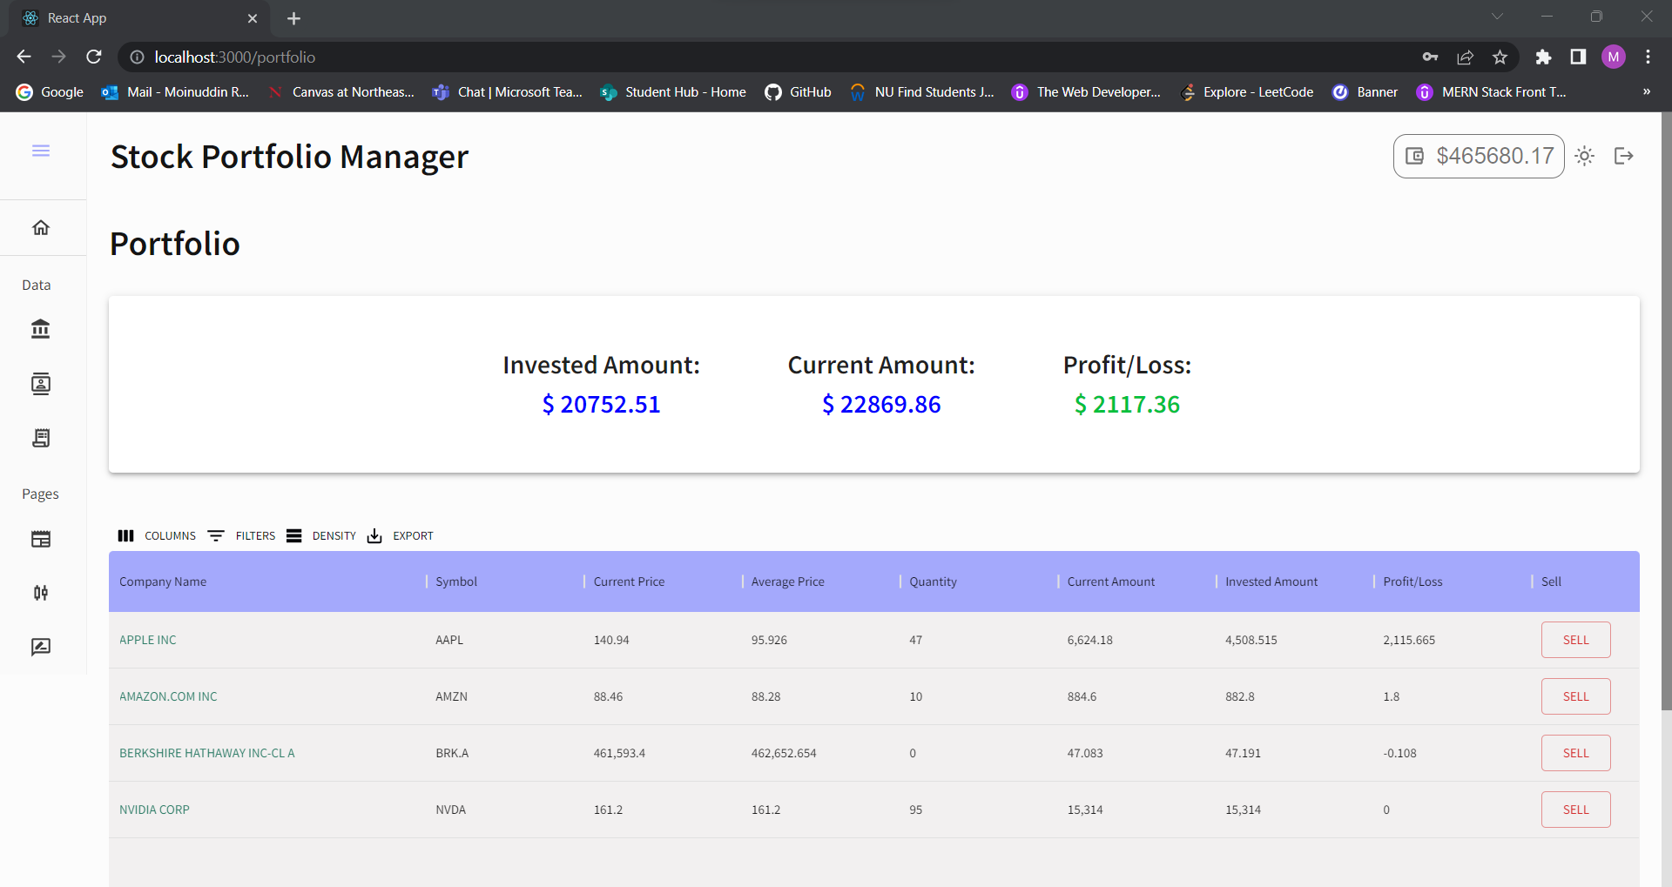

Slide 9
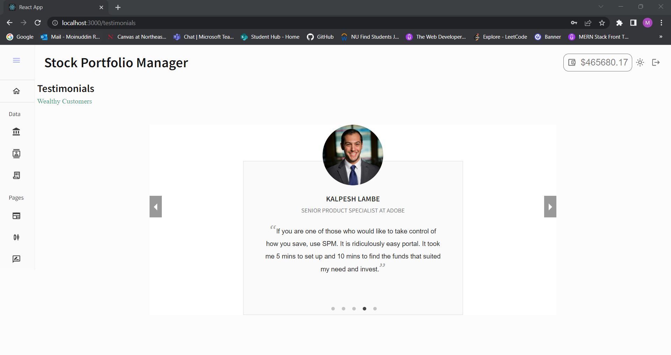

Slide 10
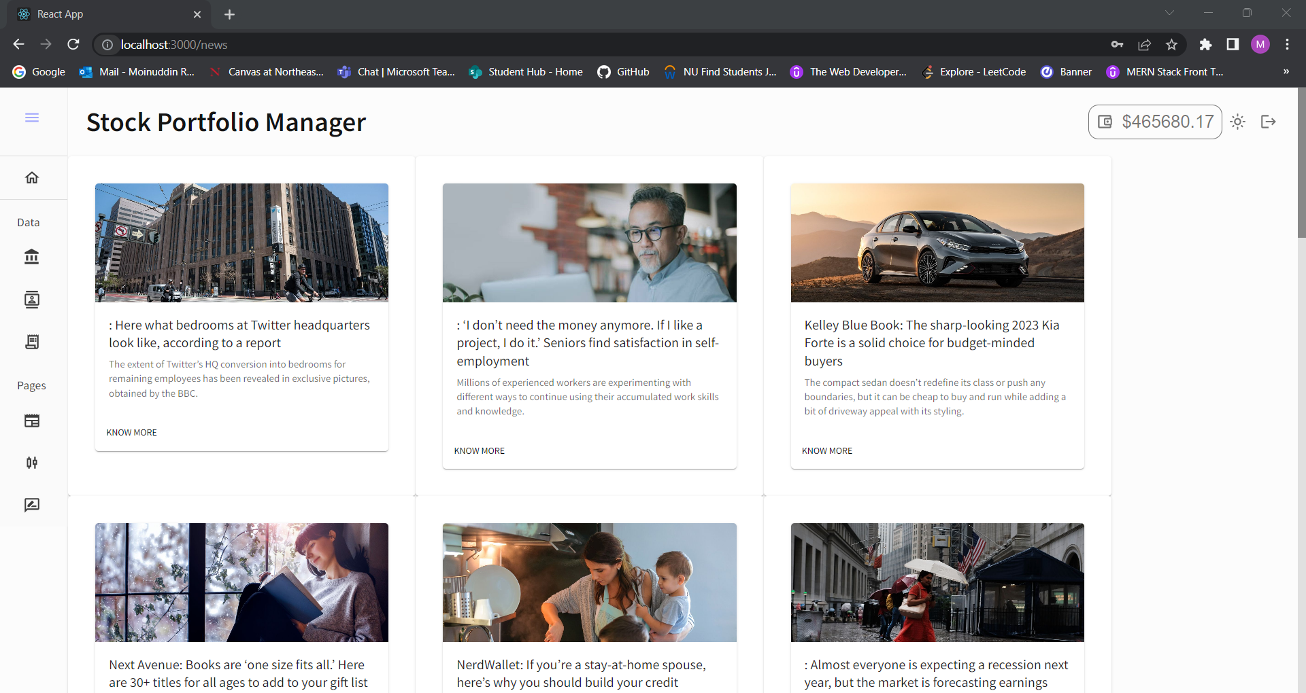

Slide 11
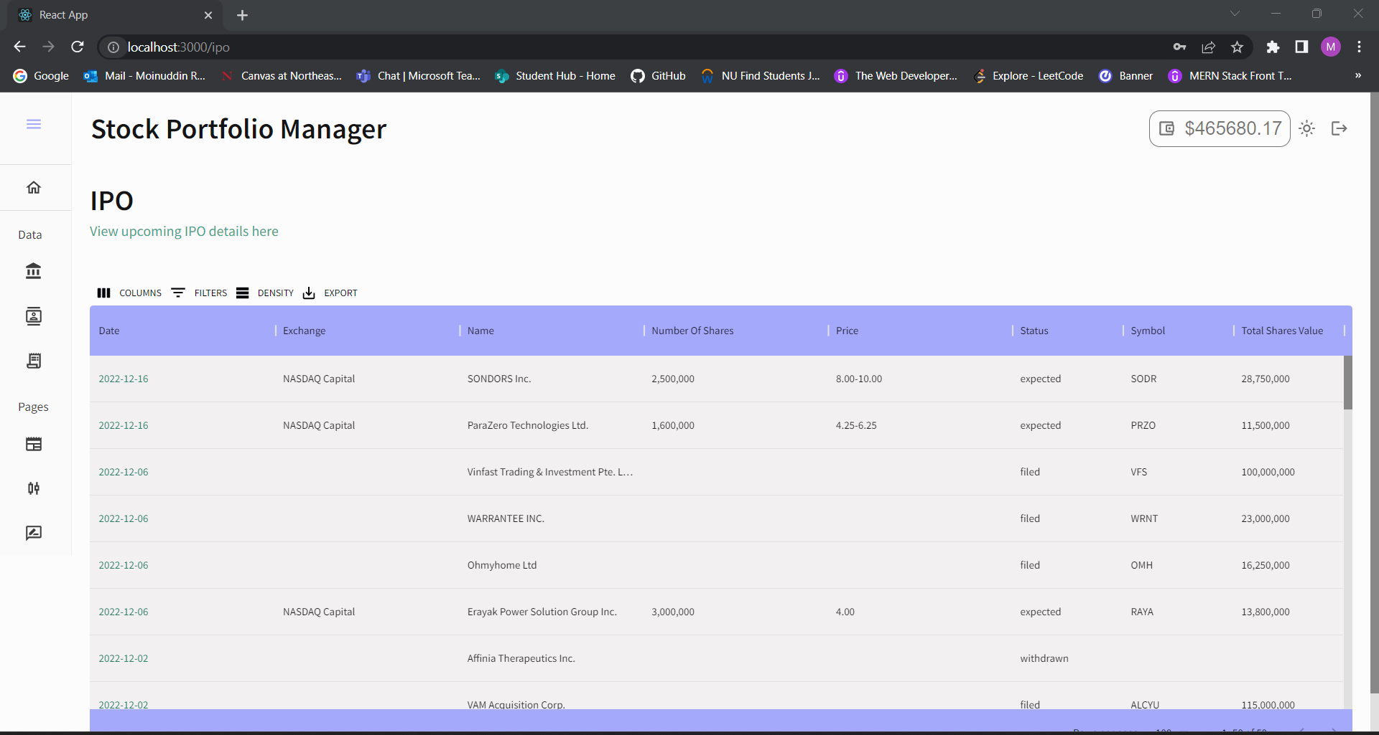

Slide 12
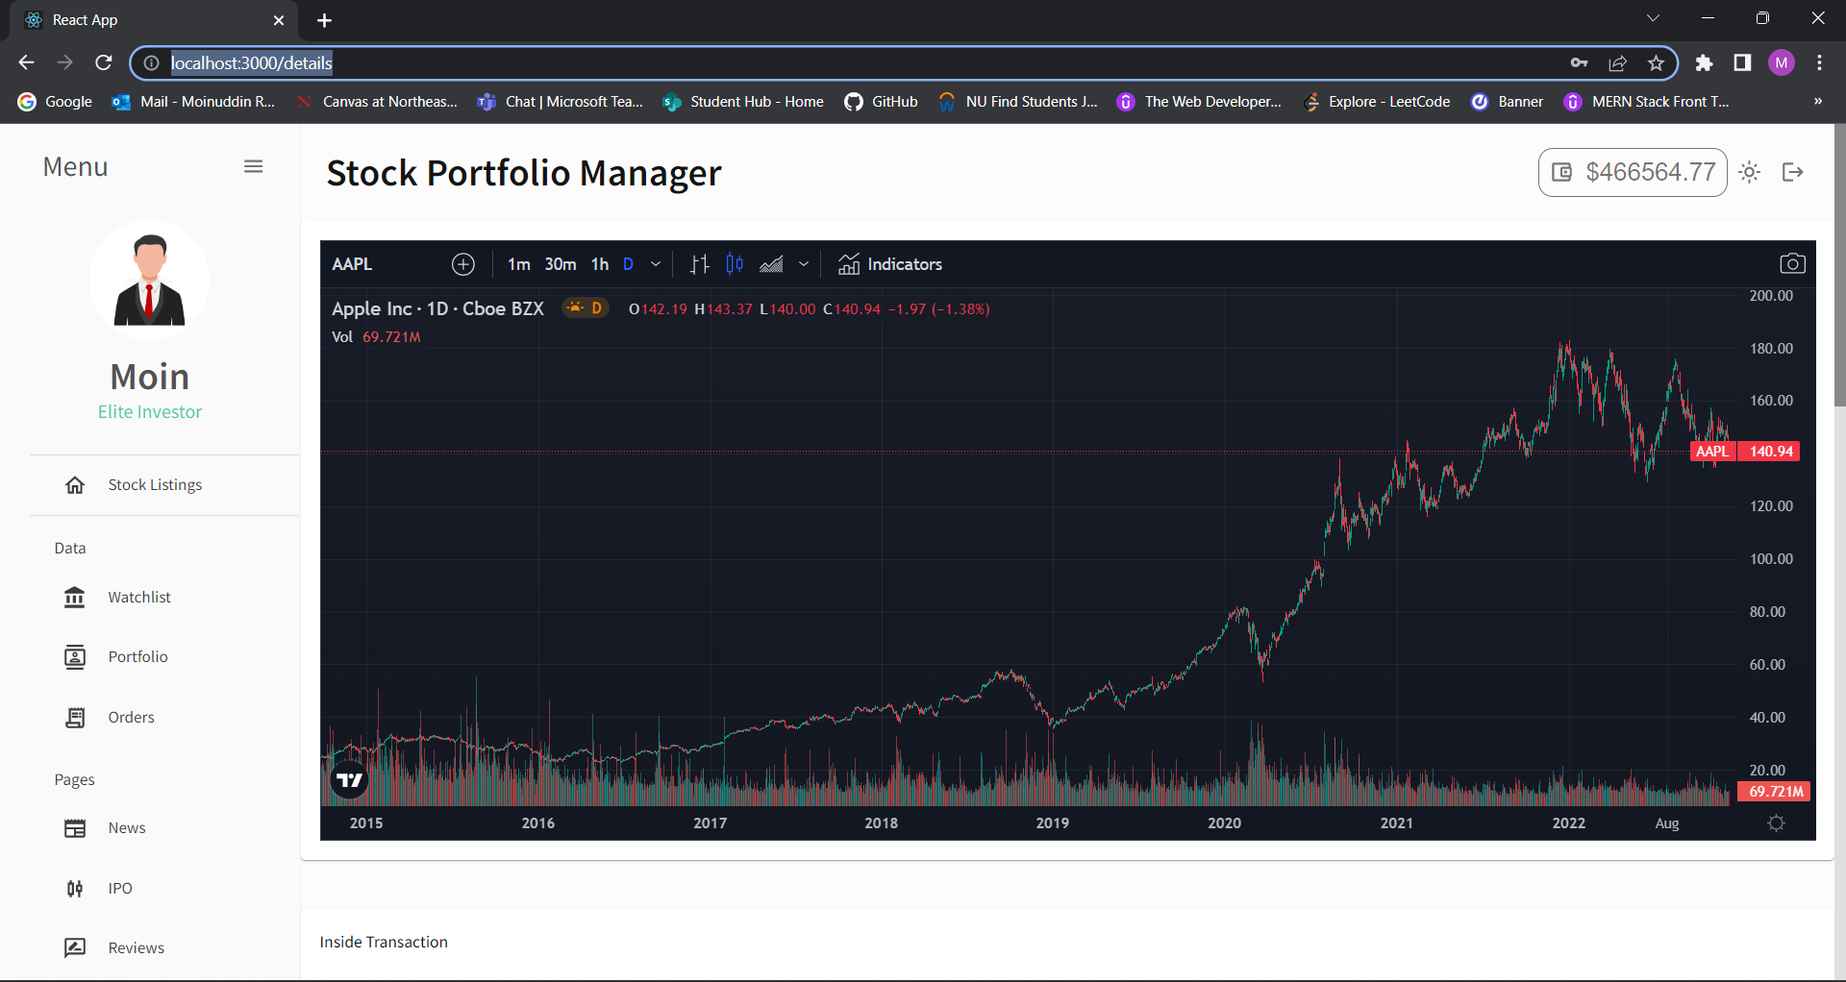

Slide 13
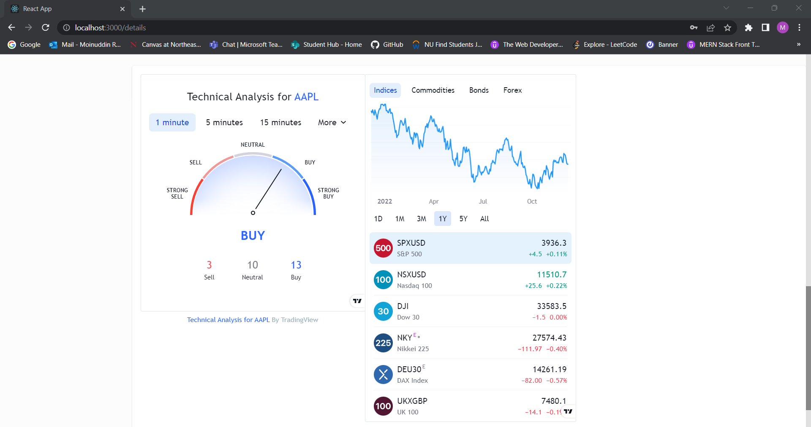

Slide 14
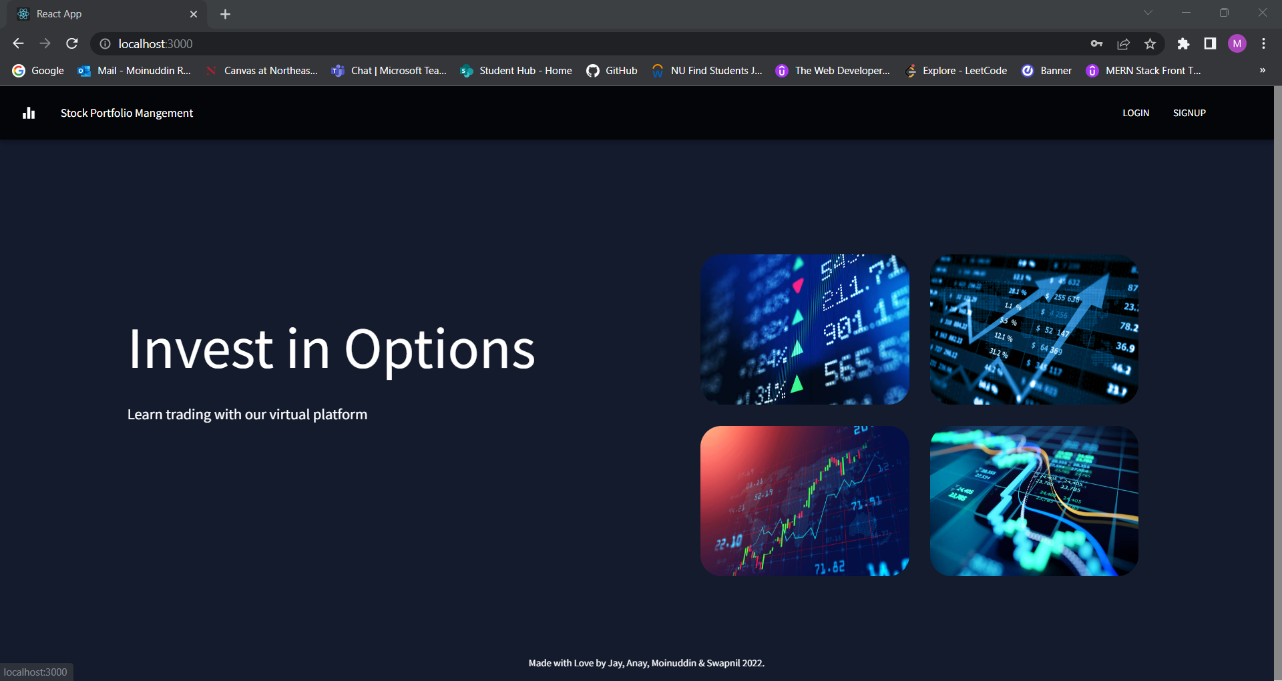

Slide 15
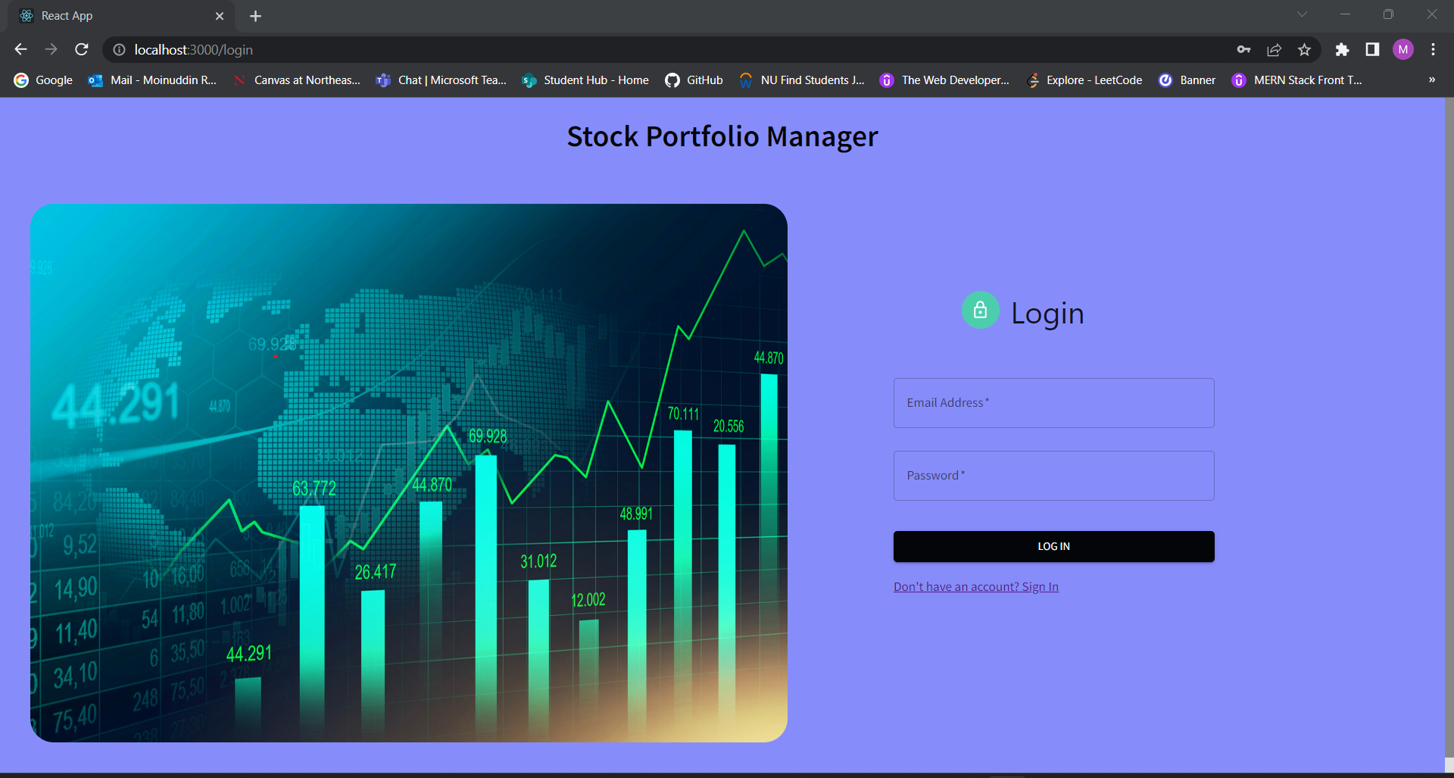

Slide 16
Thank You

